Slide 1
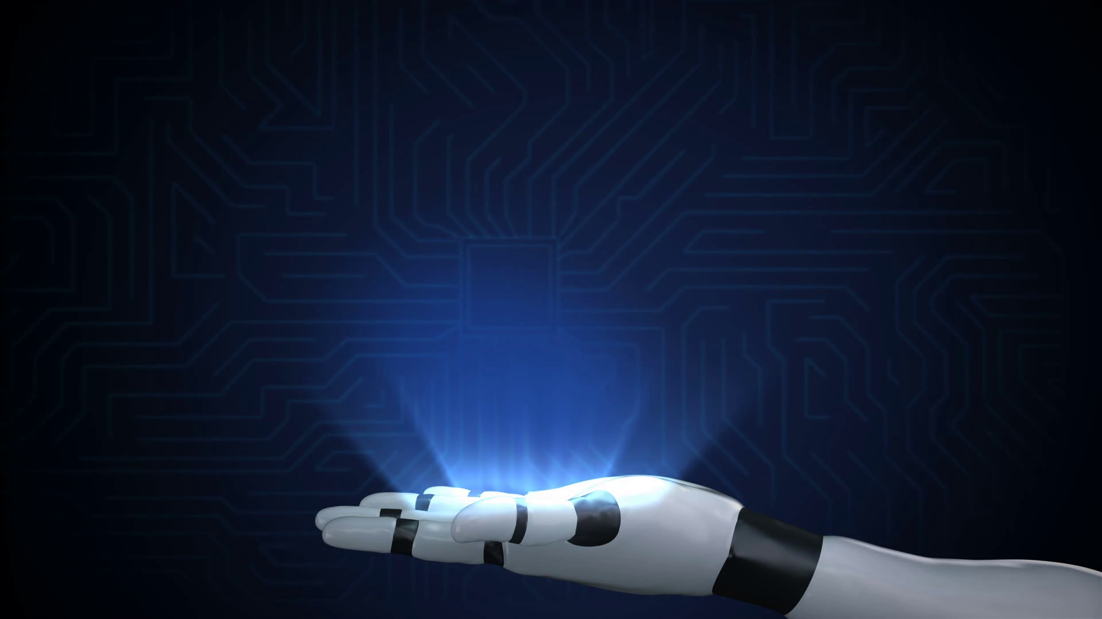
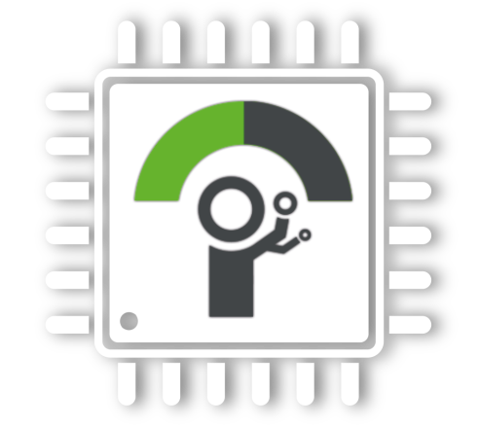
DIY Self-Balancing Robot
www.iot-geeks.org
IoT Geeks
By
Murugadoss Balasubramanian
16/09/2019

Slide 2
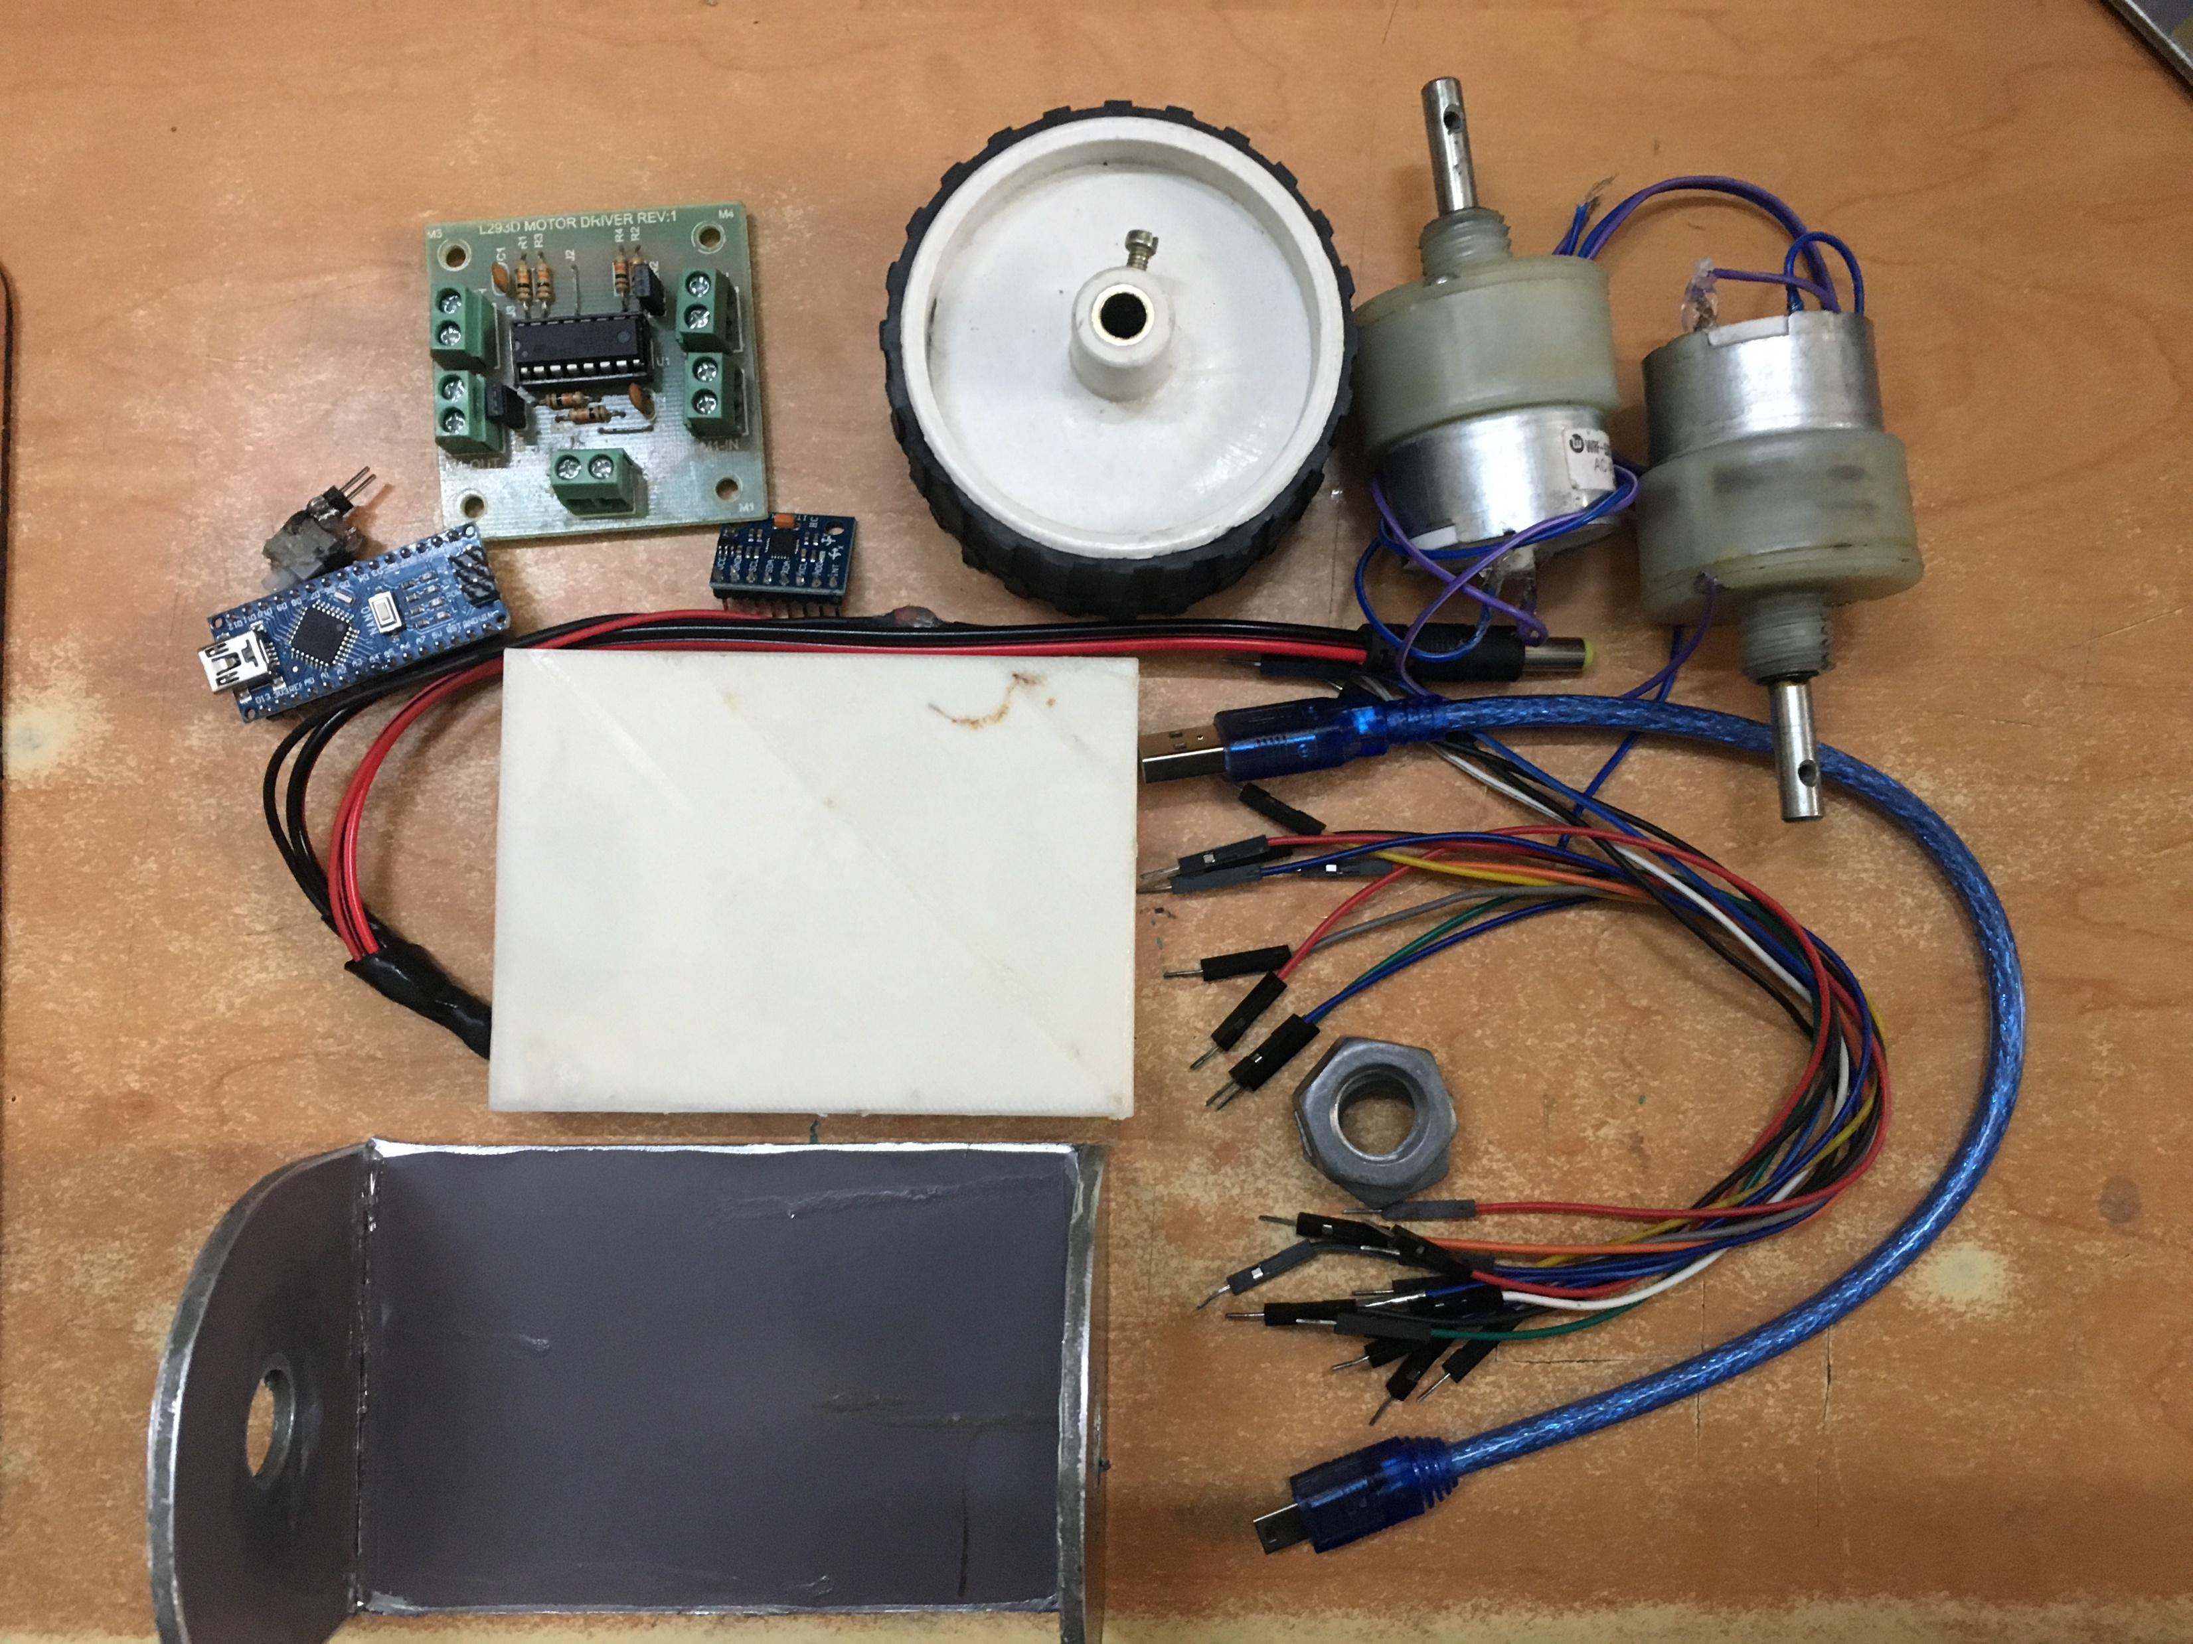
What's in the Kit
IoT Geeks
L293D Motor Controller
Wheels
Motors(9-12V)
ON/OFF
Swtich
Arduino Cable
Arduino
Nano
MPU-6050
Battery (9V)
Jumper Cable
Chassis
Arduino Cable

Slide 3
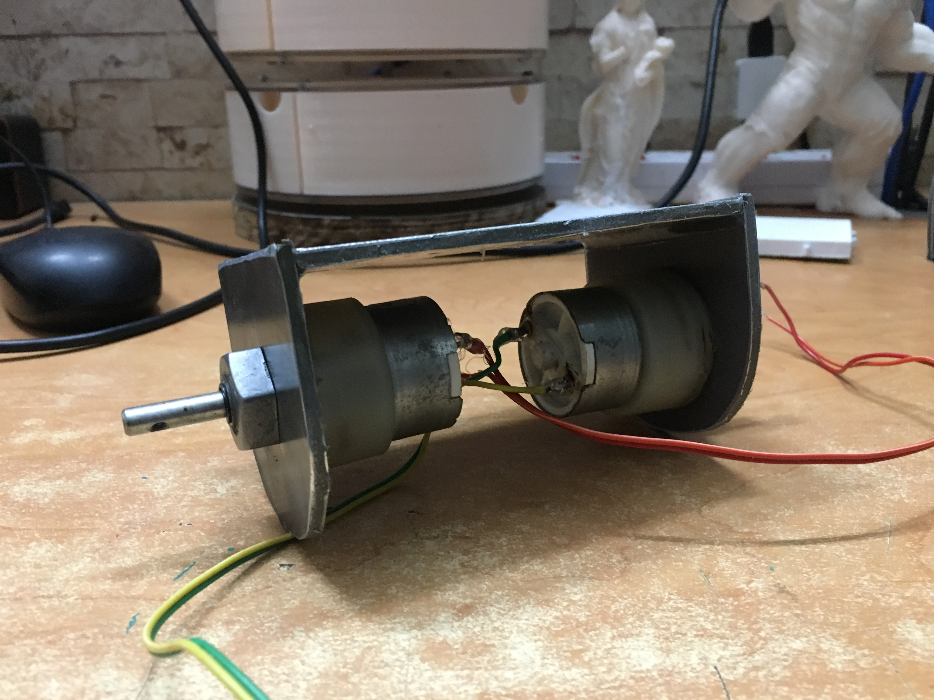
Step1: Assemble Motors
IoT Geeks

Slide 4
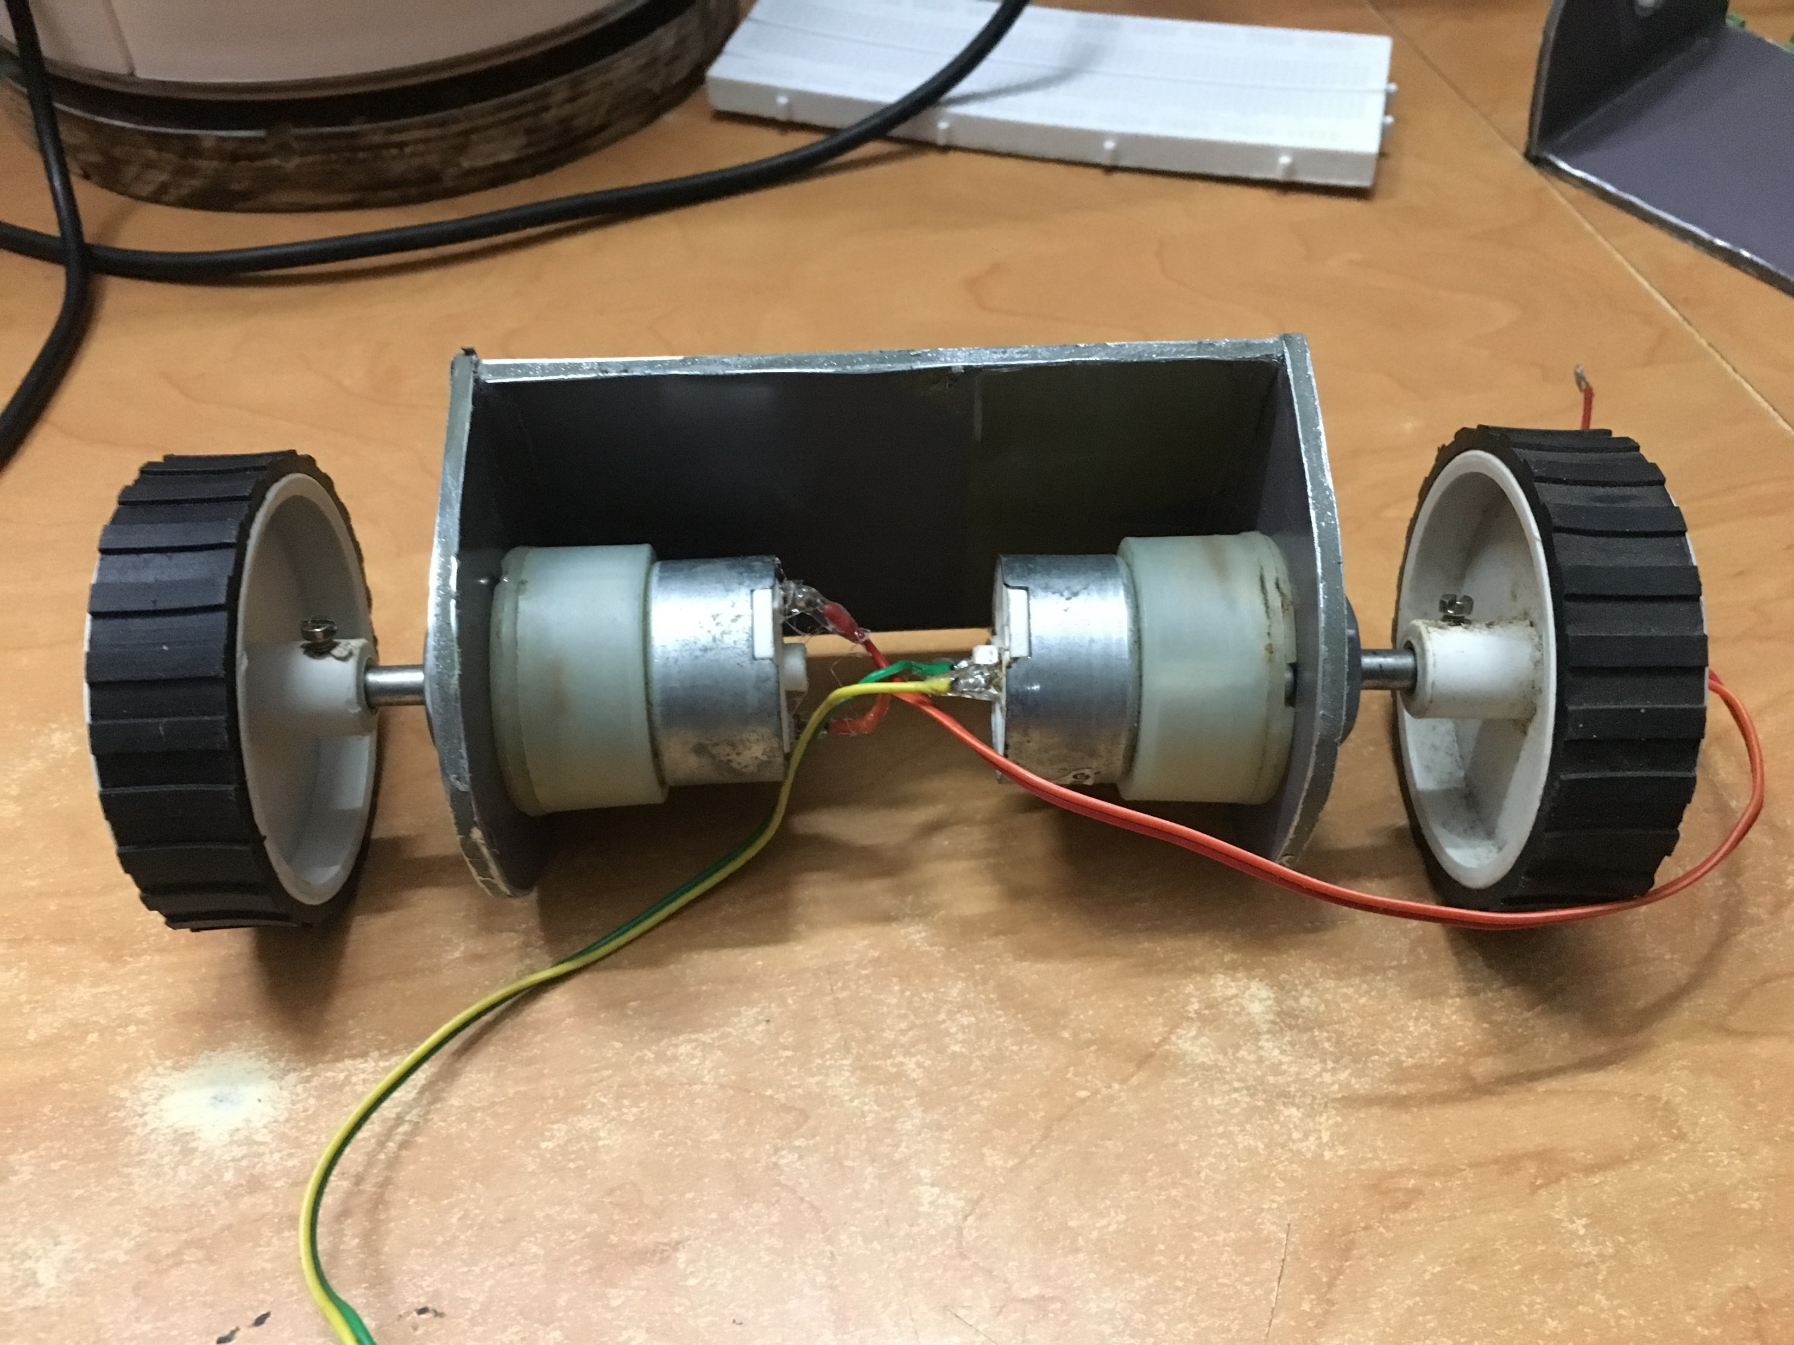
Step2: Assemble Wheels
IoT Geeks

Slide 5
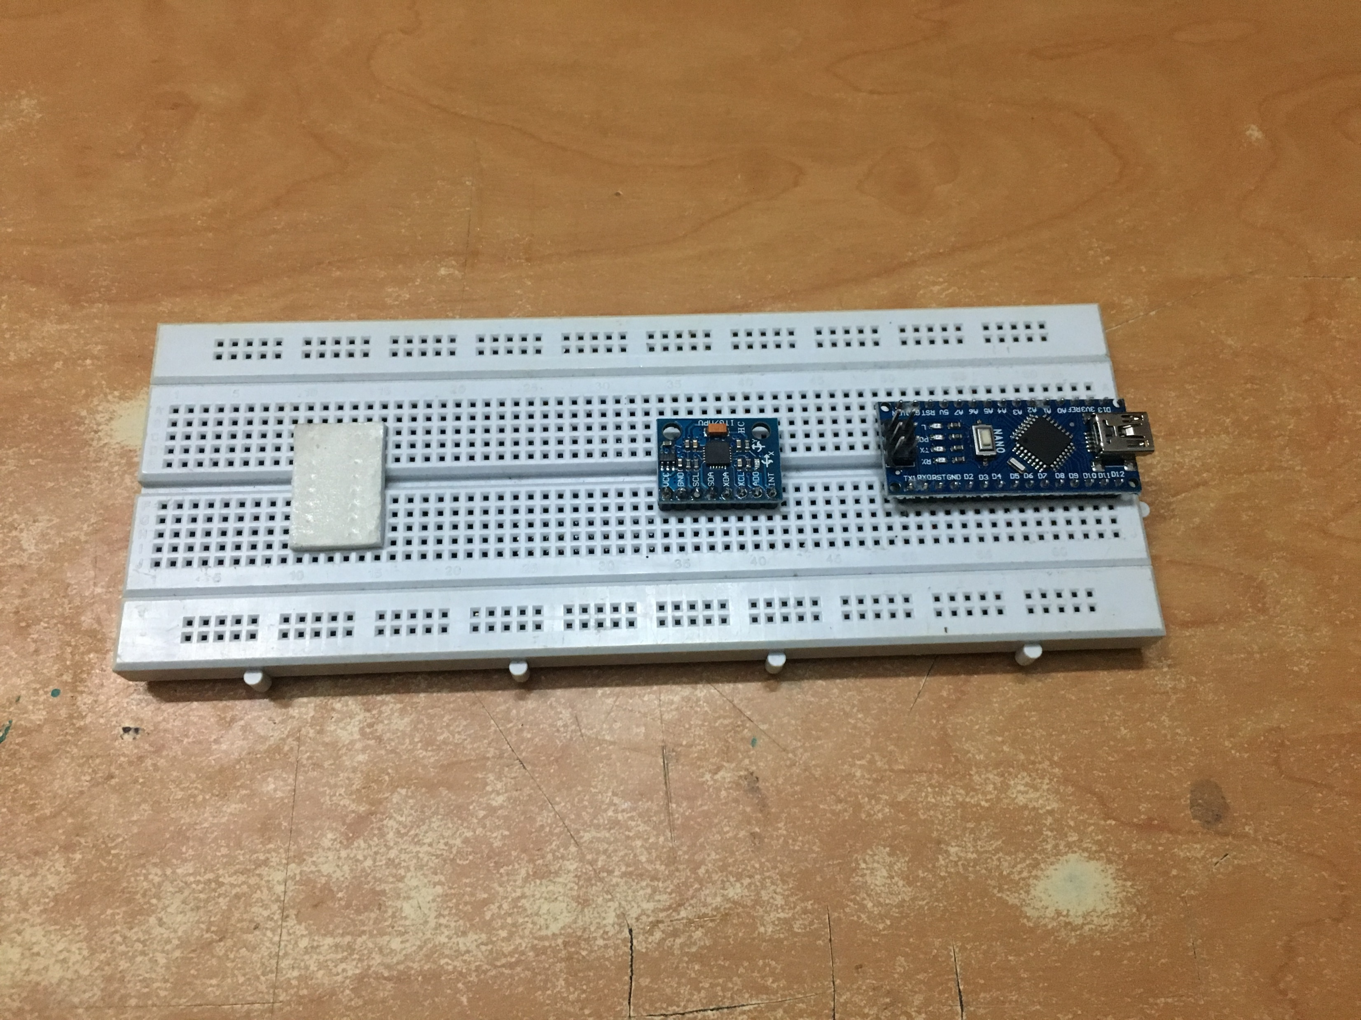
Step3: Place MPU & Arduino on breadboard
IoT Geeks

Slide 6
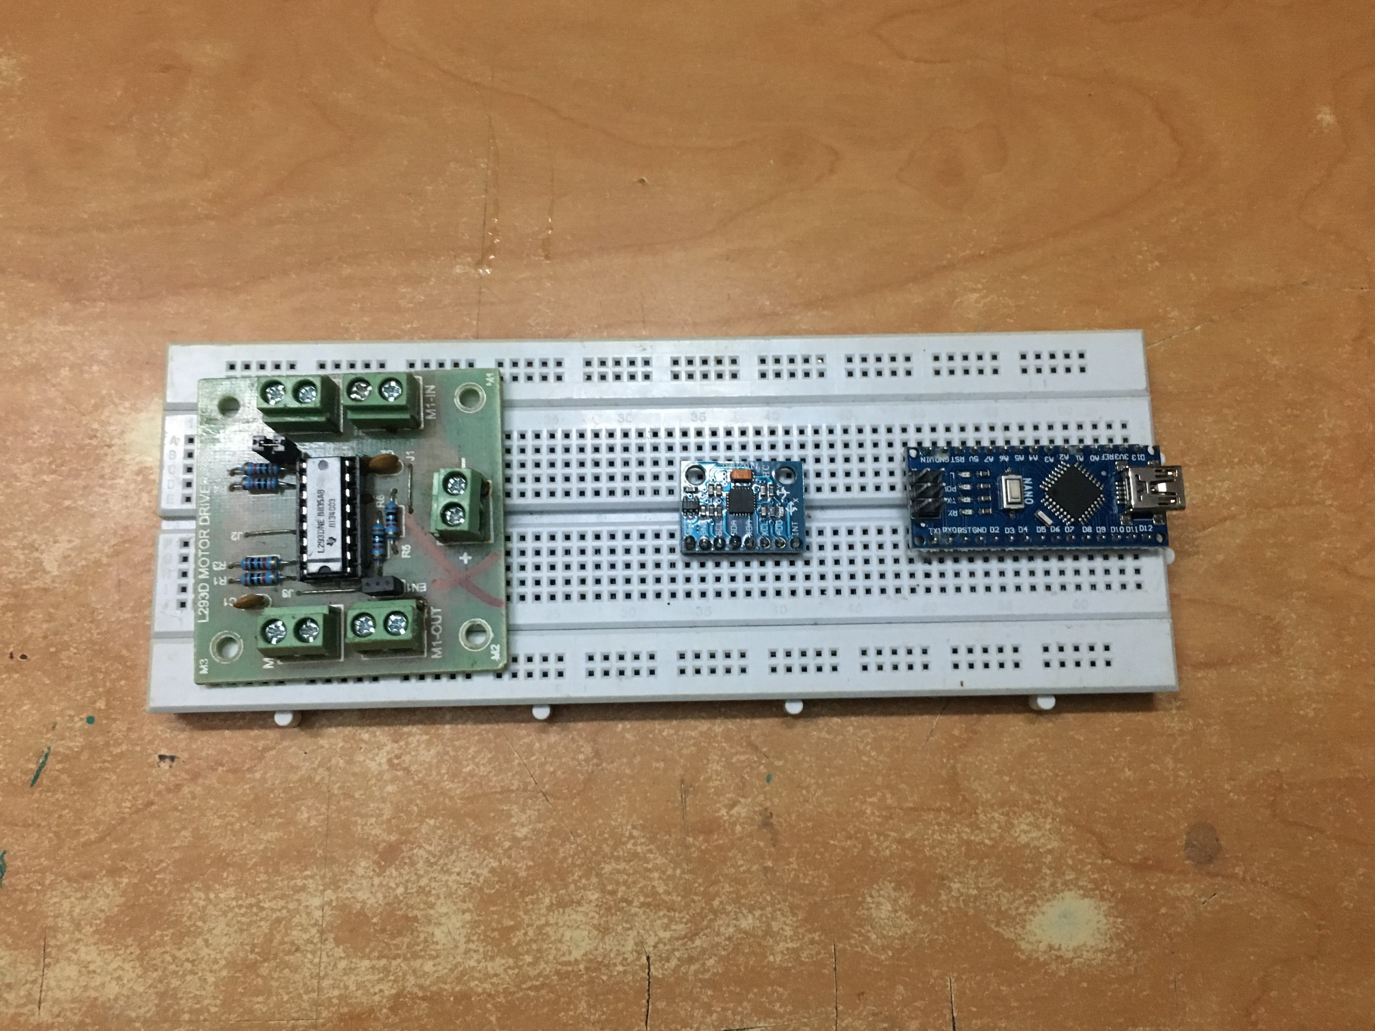
Step4: Place Motor Driver
IoT Geeks

Slide 7
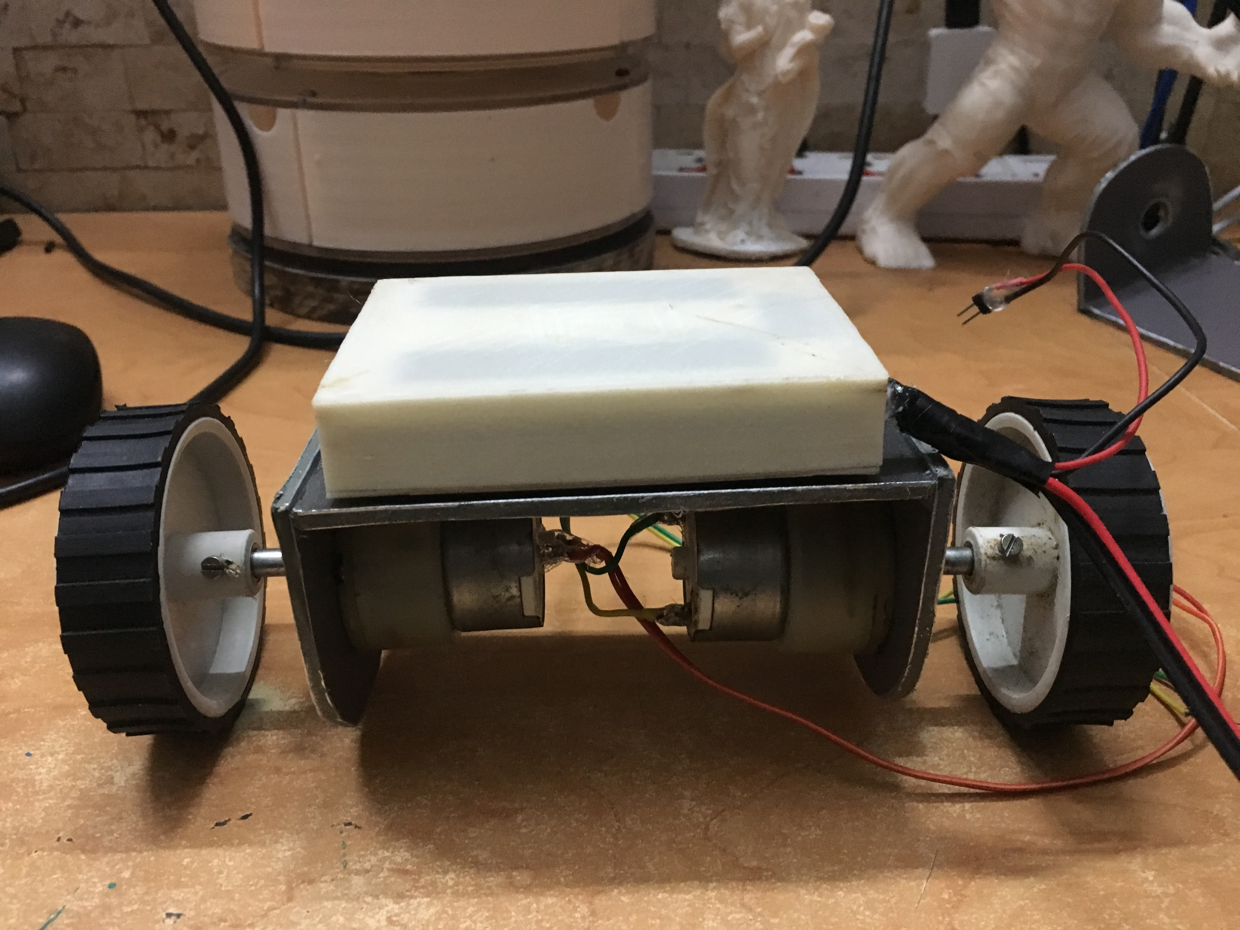
Step5: Stick Battery on Chassis
IoT Geeks

Slide 8
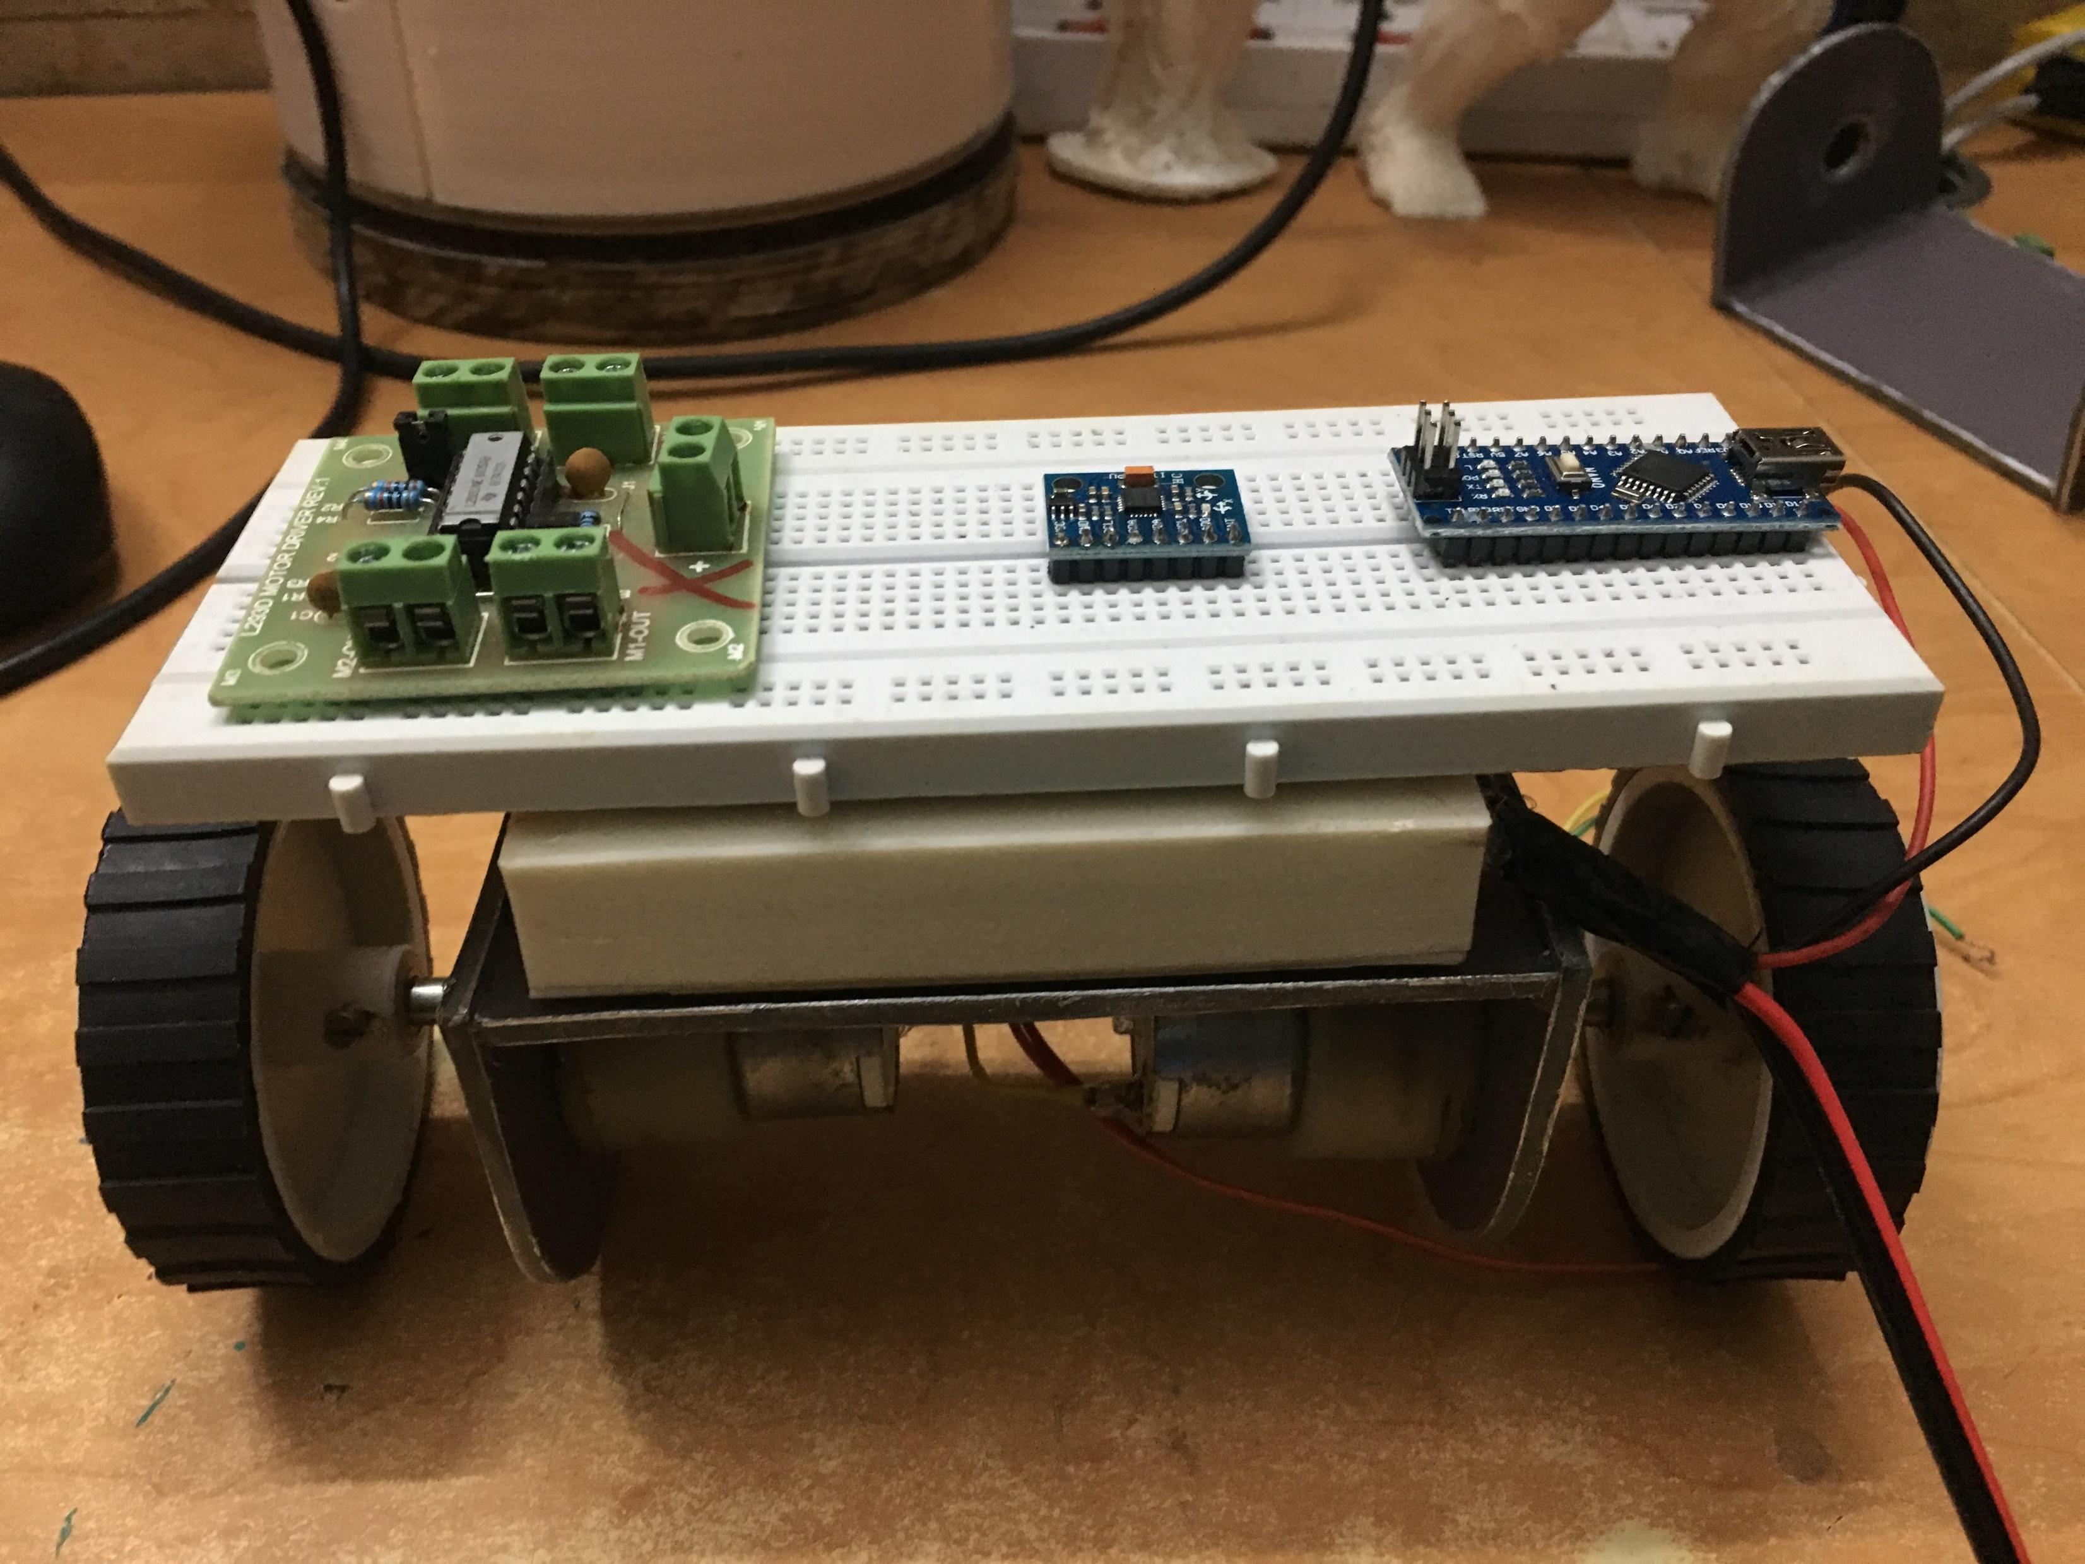
Step6: Stick Breadboard on Battery
IoT Geeks

Slide 9
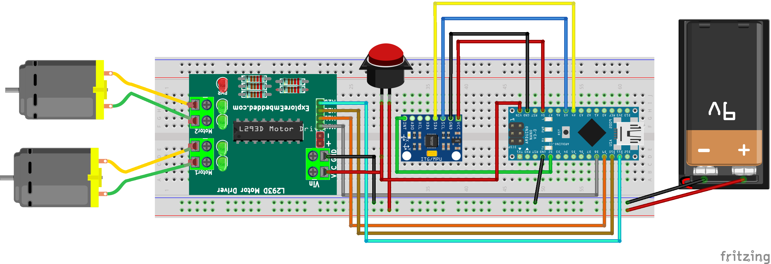
Step7: Circuit Connections
IoT Geeks

Slide 10
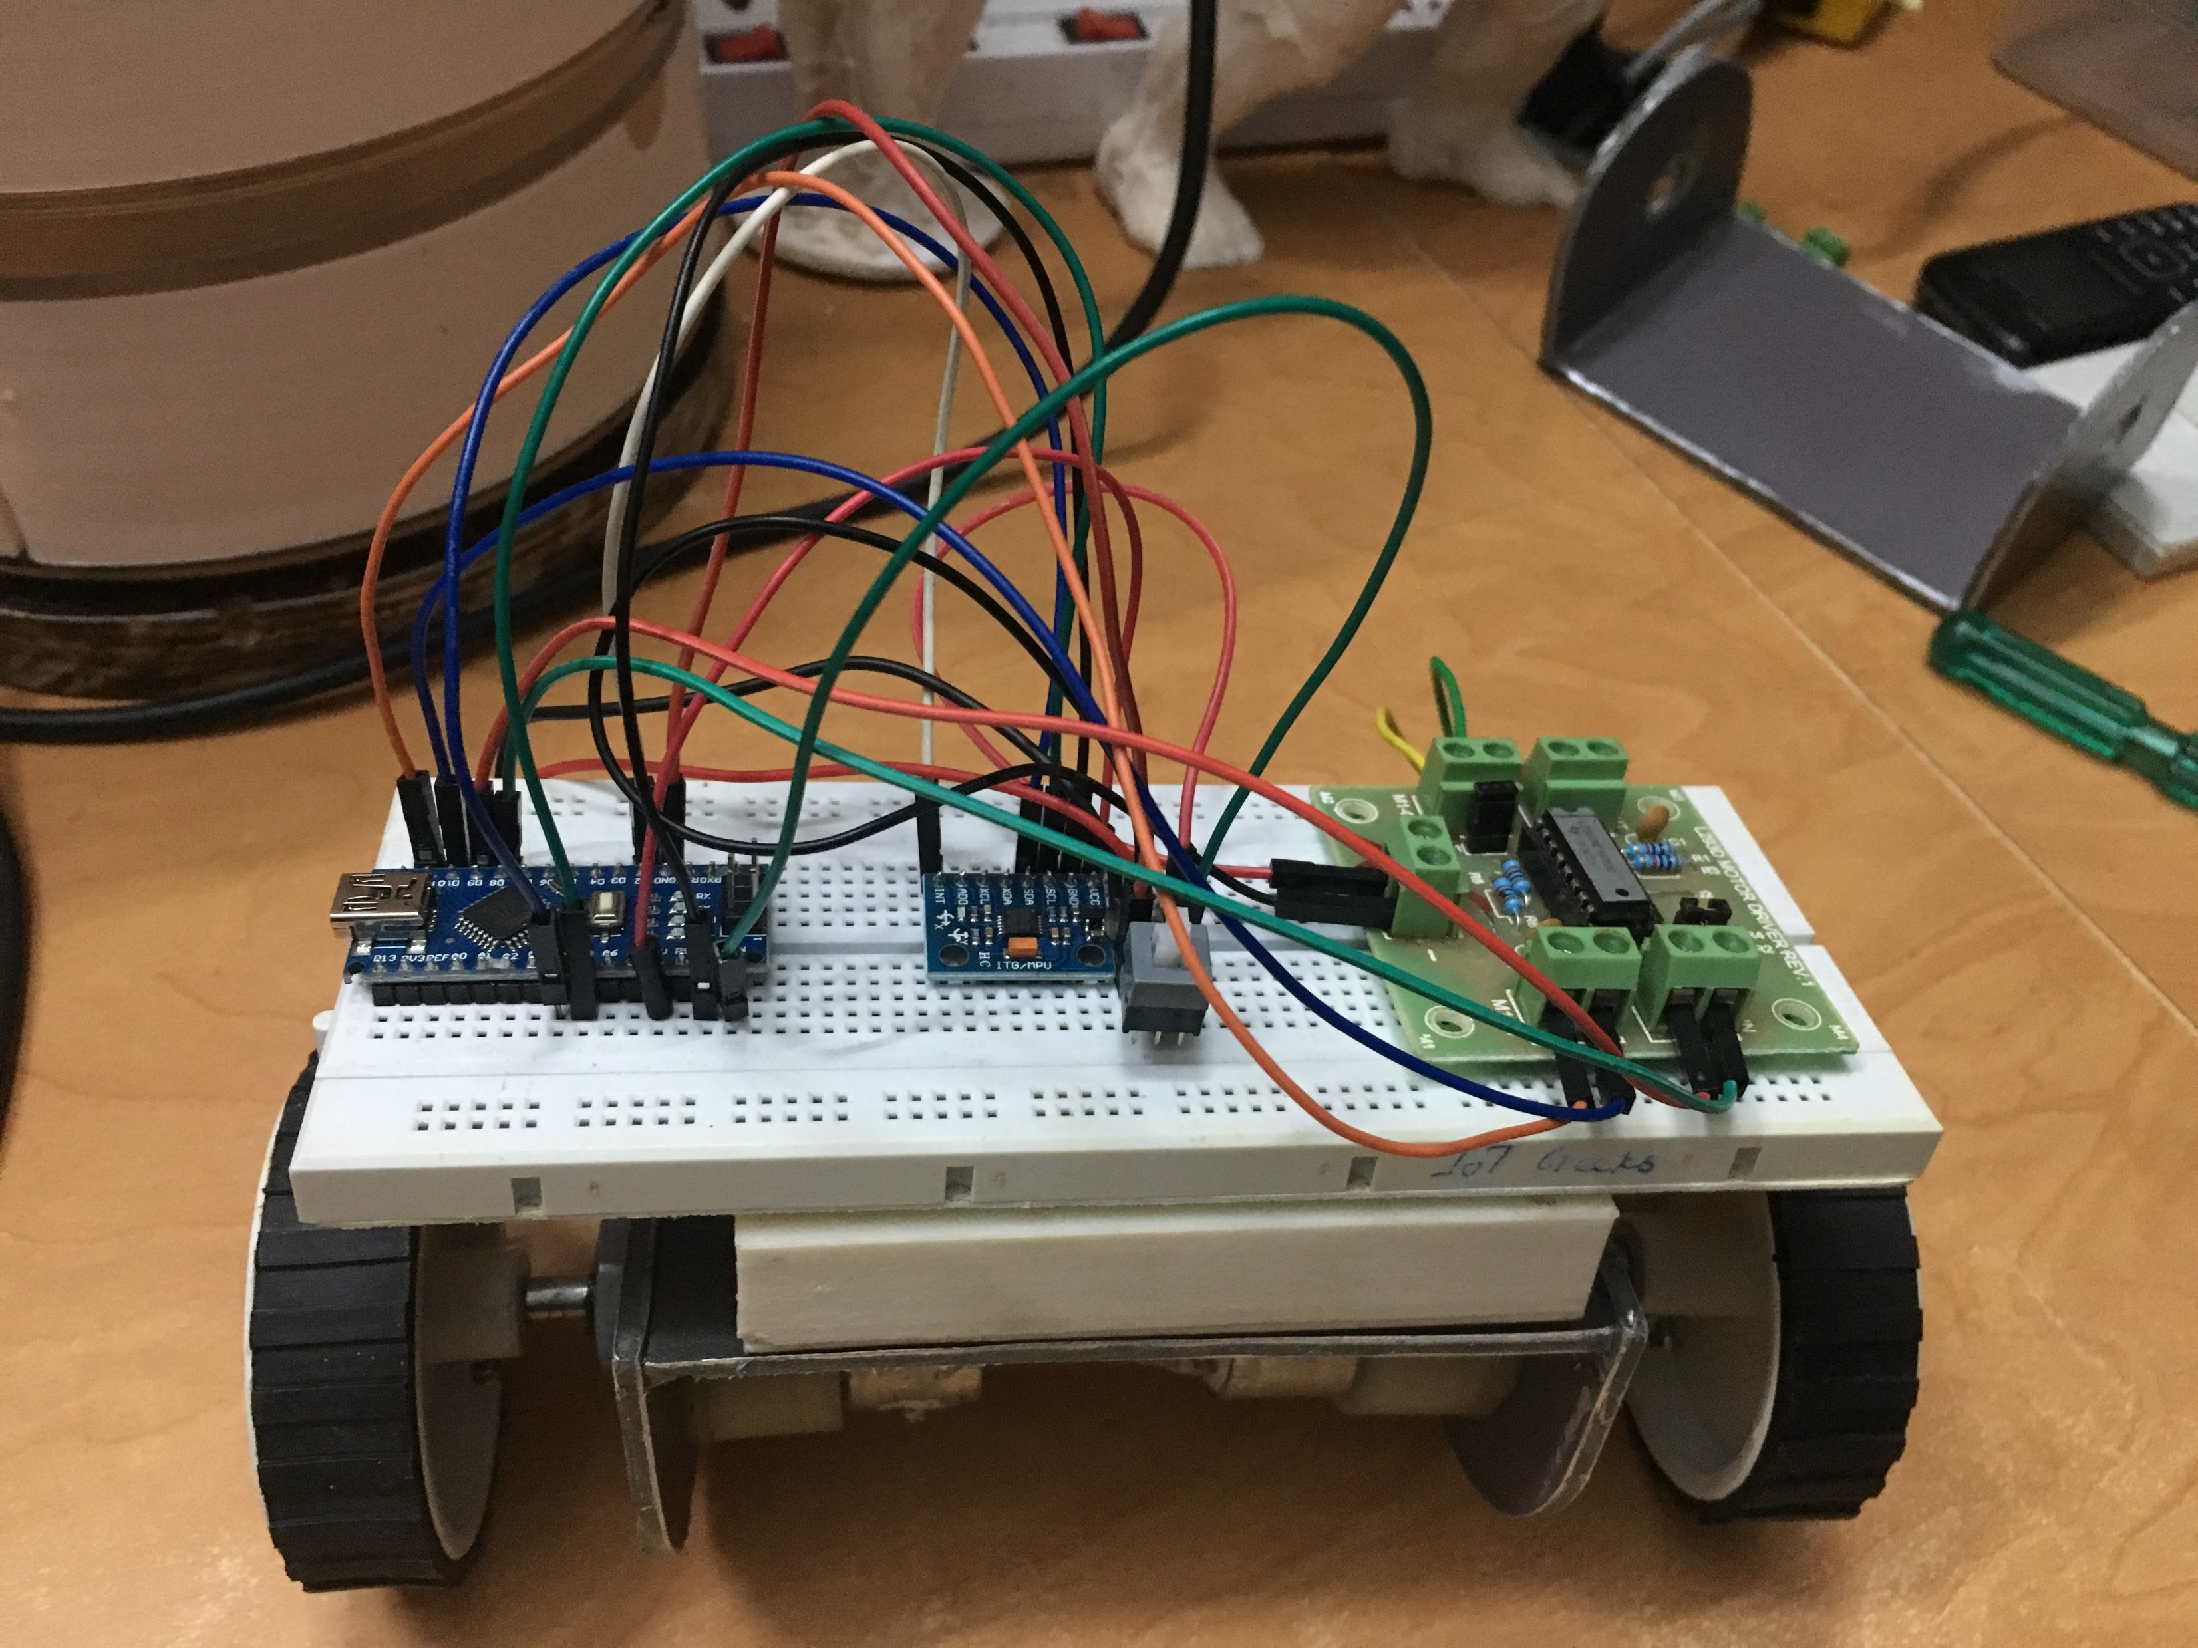
Step8: Ready
IoT Geeks

Slide 11
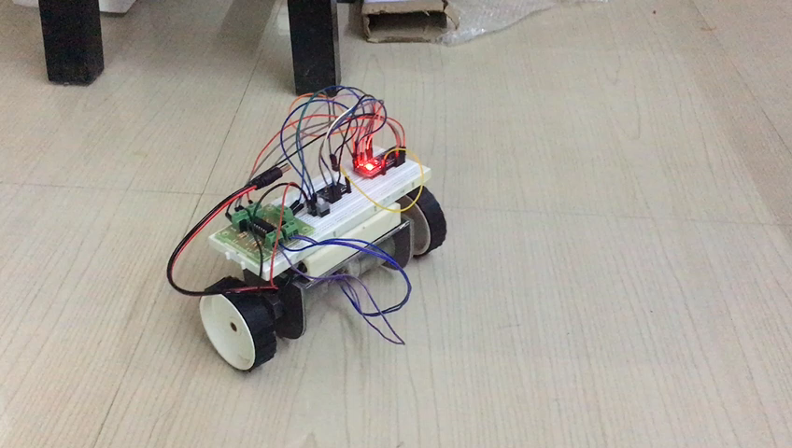
Demo!
IoT Geeks

Slide 12
Questions!
IoT Geeks

